Slide 1

PHASE 2 PROJECT
P. Rajamohan

Slide 2
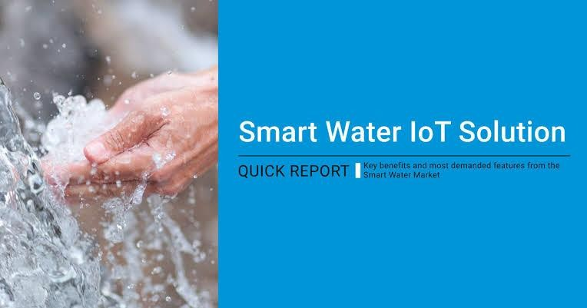
S MA R T W A T E R S Y S T E M
.

Slide 3
In Previous,Phase 1 project submission I am included about smart water system.It contains project definition,design thinking and it’s objective for smart water system
In phase 2,I using machine learning algorithm to develop my project,they are
LSTM Model
GENE Expression programming
Multivariate Adaptive regression splines

Slide 4

LSTM MODEL
In a smart water system, an LSTM (Long Short-Term Memory) is a type of artificial neural network used for various tasks related to data analysis, prediction, and optimization.
LSTMs can be applied in smart water systems in several ways:
Demand Ïoíecasting: LSTMs can analyze historical water consumption data to forecast future demand patterns. By considering factors such as time of day, day of the week, weather conditions, and special events, these networks can help utilities plan for water production and distribution more efficiently.

Slide 5
Leak Detection: LSTMs can detect abnormal water usage patterns that might be indicative of leaks in the water distribution network. Sudden increases in water consumption or unusual patterns can trigger alerts, allowing for rapid response and reduced water loss.
Quality Monitoíing: LSTMs can be used to monitor water quality. By analyzing data from sensors that measure parameters like pH, turbidity, and chemical concentrations, these networks can identify trends and deviations that may indicate water quality issues.
Neľwoík Opľimizaľion: LSTMs can assist in optimizing the overall distribution network by continuously learning and adapting to changing conditions. This can lead to more efficient water distribution, reduced energy consumption, and cost savings.

Slide 6

PROGRAM:

Slide 7
plt.figure(figsize=(10, 6))
.
plt.plot(history.history['], label='Validation Loss')
plt.xlabel('Epochs')
plt.ylabel('Loss')
plt.legend()
plt.show()
y_pred = model.predict(X_test) y_pred=scaler.inverse_transform(y_pred) plt.figure(figsize=(12, 6))
plt.plot(y_test, label='Actual Consumption', color='blue') plt.plot(y_pred, label='Predicted Consumption', color='red') plt.xlabel('Time Steps')
plt.ylabel('Consumption')
plt.legend()
plt.show()

Slide 8

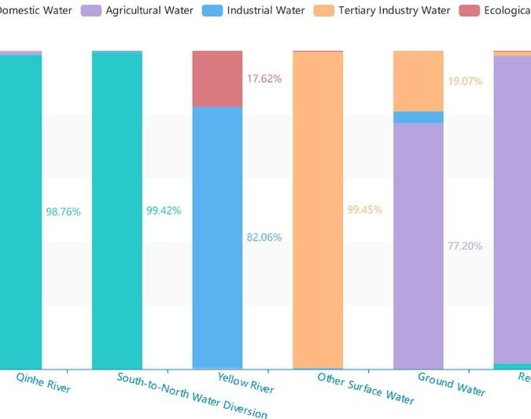
Output of LSTM

Slide 9
GENE EXPRESSION PROGRAMING :
Gene Expression Programming (GEP) is a computational technique used in various fields, including smart water management, to optimize and automate processes. In the context of smart water management
GEP can be applied as follows:
Optimizing Wateí Distíibution Networks: GEP can be used to design and optimize the layout of water distribution networks. It can generate mathematical expressions or rules that help in efficient water flow and pressure control, minimizing energy consumption, and reducing water loss.
Píedictive Modeling: GEP can create predictive models for various aspects of water management. For example, it can develop models to forecast water demand, detect leaks, predict water quality, or estimate the performance of water treatment processes. These models can be based on historical data and sensor inputs.

Slide 10



Slide 11







Slide 12
.• .fitness_scores = [fitness(''.join(individual), data) for individual in population]
elite_indices = np.argsort(fitness_scores)[:population_size // 2]
elite_population = [population[i] for i in elite_indices]
new_population = []
while len(new_population) < population_size:
parent1 = random.choice(elite_population)
parent2 = random.choice(elite_population)
crossover_point = random.randint(1, len(parent1) - 1)
child = parent1[:crossover_point] + parent2[crossover_point:]
if random.random() < 0.1:
mutation_point = random.randint(0, len(child) - 1)
child[mutation_point] = random.choice(terminals + functions)
new_population.append(child)
population = new_population
best_individual = min(population, key=lambda x: fitness(''.join(x), data))
best_expression = ''.join(best_individual)

Slide 13
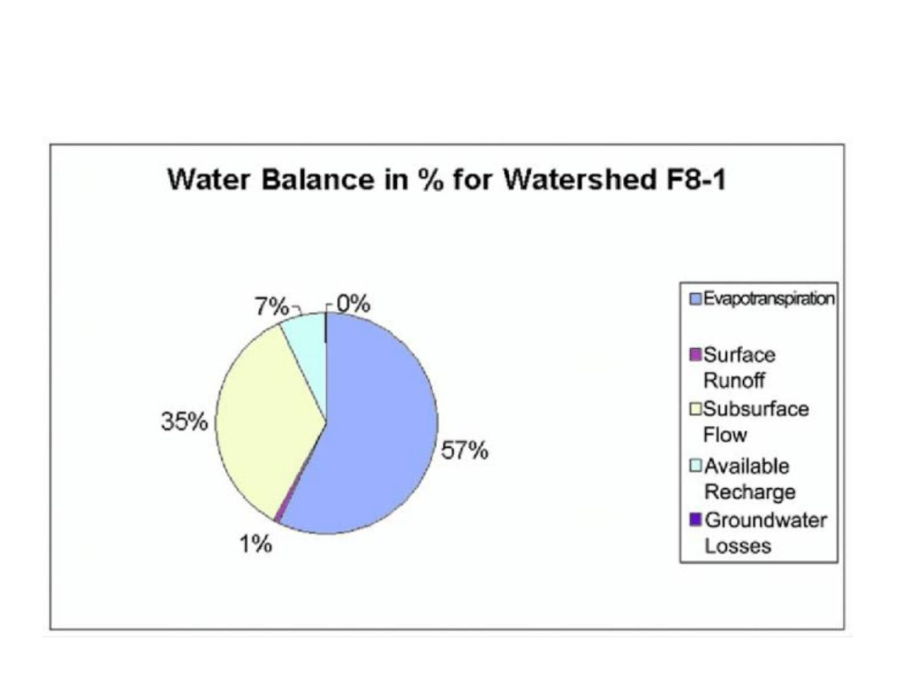
OUTPUT OF GEP:
.

Slide 14
MULTIVARIATE ADAPTIVE REGRESSION SPLINESS:
Multivariate Adaptive Regression Splines (MARS) is a statistical technique used for modeling complex relationships between multiple variables. In the context of a smart water system, MARS can be applied to analyze and predict various factors related to water quality, usage, or distribution. MARS works by partitioning the data into segments and fitting linear regression models within each segment, allowing for nonlinear and interactive effects to be captured.
This approach can help in optimizing the performance of a smart water system by understanding how different variables, such as temperature, flow rates, water quality parameters, and other relevant factors, interact and influence the system's behavior. MARS can be a valuable tool for data-driven decision-making and improving the efficiency and reliability of water distribution and treatment processes.

Slide 15






PROGRAM:

Slide 16
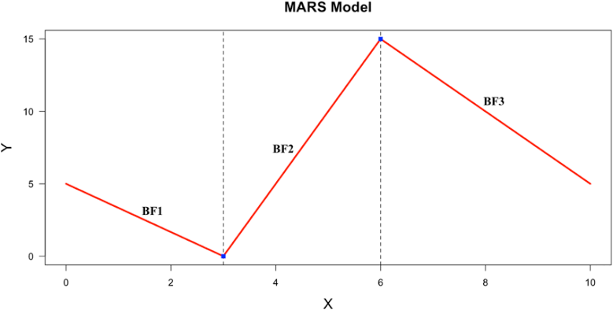
OUTPUT OF MARS:
.

Slide 17
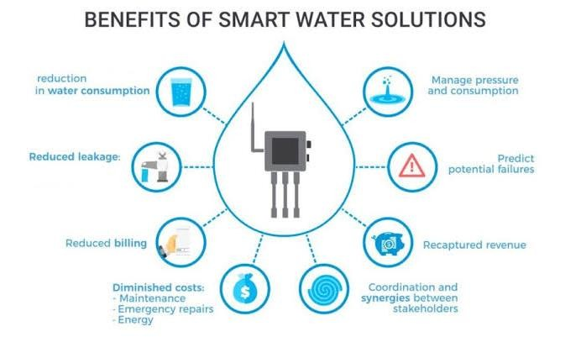
CONCLUSION:
Machine learning models analyze water quality trends and device monitoring and management architecture. The results display that the proposed method manages water monitoring and accessing water parameters efficiently than other works.

Slide 18


